Slide 1

The Evolution of a Content Delivery Network: A 21-Year Perspective
Bruce Maggs
Duke University
Akamai Technologies

Slide 2
In the beginning…
Akamai offered to deliver objects that appeared on web pages
The goal was to speed up page load times
… and reduce infrastructure investment for content providers

Slide 3
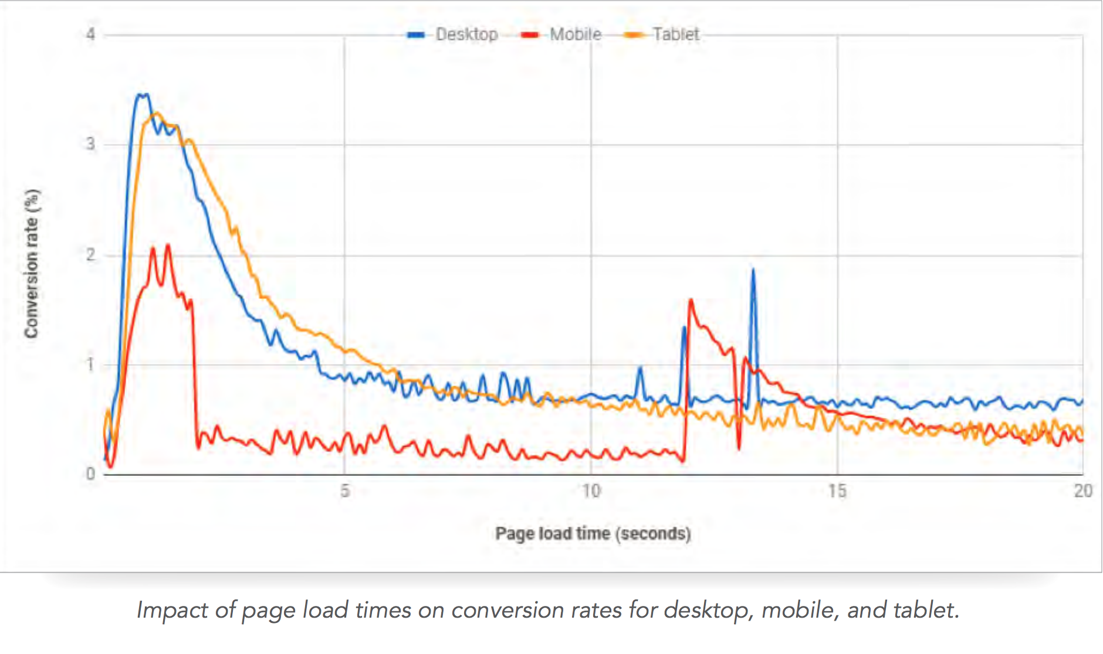
Impact of PLT on conversion on e-commerce Web sites
Source: Akamai, State of Online Retail Performance, 2017 Holiday Perspective

Slide 4
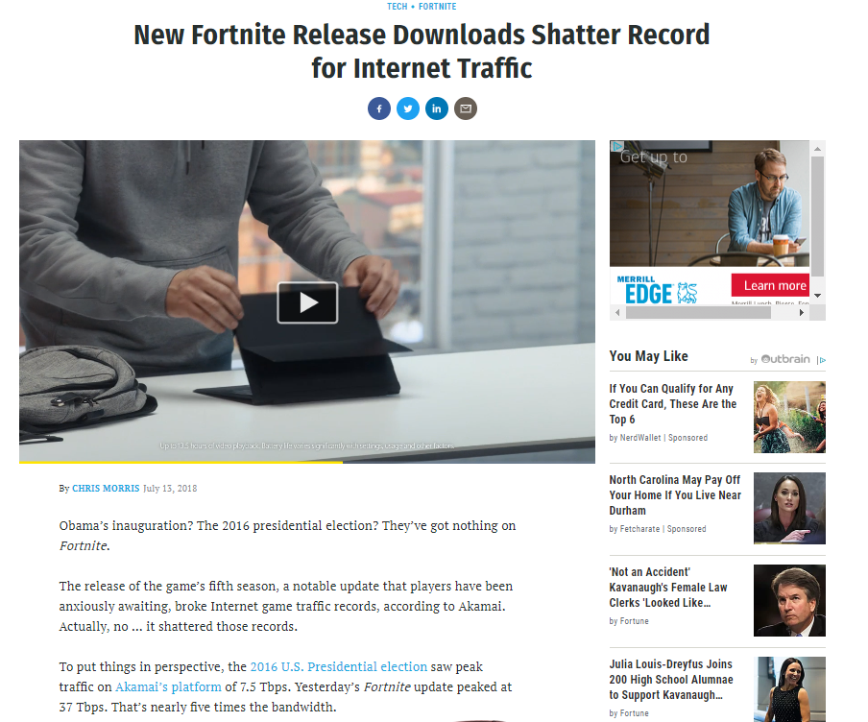
37Tbps

Slide 5
Embedded Image Delivery
Embedded URLs are Converted to ARLs
<html>
<head>
<title>Welcome to xyz.com!</title>
</head>
<body>
<img src=“
<img src=“
<h1>Welcome to our Web site!</h1>
<a href=“page2.html”>Click here to enter</a>
</body>
</html>
ak
http://www.xyz.com/logos/logo.gif”>
http://www.xyz.com/jpgs/background.jpg”>
Notes:
Very simple process.

Slide 6
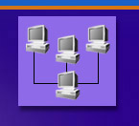


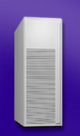
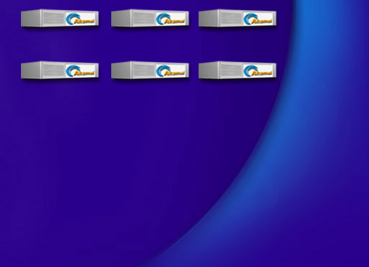


Akamai DNS Resolution
4
ak.xyz.com
.com .net
Root (Verisign)
5
10.10.123.5
xyz.com’s nameserver
a212.g.akamai.net
a212.g.akamai.net
8
7
9
6
15.15.125.6
ak.xyz.com
select cluster
10
a212.g.akamai.net
20.20.123.55
11
Akamai High-Level DNS Servers
12
a212.g.akamai.net
30.30.123.5
13
Akamai Low-Level DNS Servers
End User
Local Name Server
select servers within cluster
16
1
3
14
U.S. Patent 6108730, “Global Hosting System,” F. T. Leighton and D. M. Lewin, 8/22/2000.
2
Browser’s Cache
15
OS
Notes:
One of many ways—don’t have to do cname but it is easy. Note that usually address is already in local name server and you don’t do all these steps.

Slide 7
Mapping Clients to Akamai Clusters
Many “no brainers” – servers co-located with clients, e.g., on university campuses
Otherwise, make decisions based on active measurements

Slide 8
Wide Area Network Measurement
X
1
2
3
4
Traceroute to all important name servers
Core point X is the first router at which all paths to name servers 1, 2, 3, and 4 intersect.
X can be viewed as the straddling the core and the edge of the network.

Slide 9
Identifying Core Points
500,000 nameservers
reduced to
30,000 core points
7,000 account for 95% end-user load
ping these continuously

Slide 10
Next Service: Streaming Media
Proprietary servers and players
Real, Windows Media, Quicktime, Flash
UDP-based protocols
Special-purpose network for live streaming built for Steve Jobs

Slide 11







Live Streaming Architecture
x
1 2 3 4
Satellite
Downlink
Satellite
Uplink
X
1 2 3 4
1 2 3 4
X X X X
Encoding
Entry Point
1 2 3 4
x
1 2 3 4
Top-level reflectors
Regions

Slide 12
Streaming Today
Everything over TCP/HTTP(S)
Client (typically JavaScript) makes all decisions
“Brokers” may choose from multiple CDNs
Highly commoditized, low margin business

Slide 13
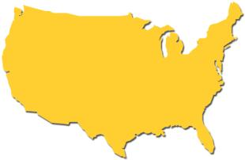

FirstPoint – DNS (built for Yahoo!)
Selects from among several mirror sites operated by content provider

Slide 14
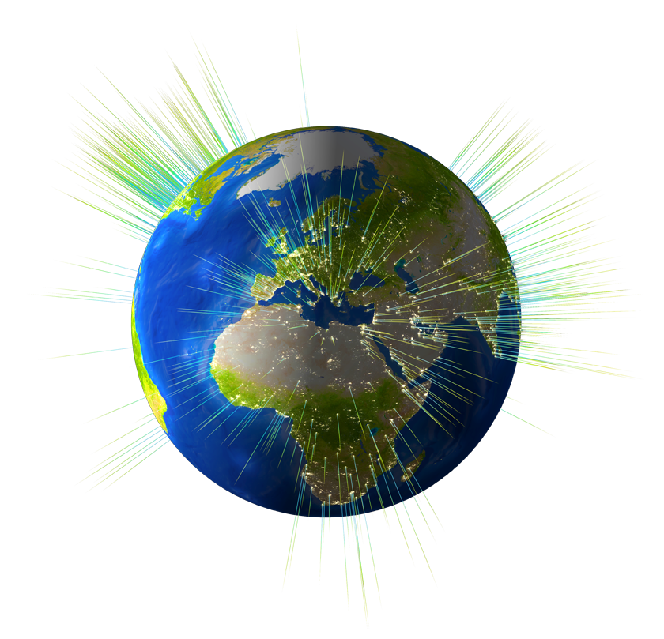
The Akamai Platform and Services
A Global Platform:
Delivering Content for 130,000+ Domains
All top 20 global ecommerce sites
All top 30 media & entertainment companies
16 of the top 20 global banks
All major anti-virus software vendors
240,000+ Servers
1,700+ Networks
3,300+ Physical Locations
750+ Cities
130+ Countries
Daily Statistics:
80+ Tbps traffic served
600+ million IPv4 addresses seen
3+ trillion requests served
260+ terabytes compressed logs

Slide 15
Moving Web Applications to the Edge
Standard three-tiered architecture
Web Server
App Server
DB

Slide 16
Original CDN Application
Clients
Internet core
CDN nodes
Content providers
Notes:
Note that the CDN solution may easily move the web server and application server to edge proxy nodes, but the centralized database server quickly becomes a performance bottleneck

Slide 17
CDN Application Services
Huge investment to support IBM WebSphere at edge
Internet
DB
Users
But… high latency to database server, and for data-intensive applications database server becomes the bottleneck.
Notes:
Note that the CDN solution may easily move the web server and application server to edge proxy nodes, but the centralized database server quickly becomes a performance bottleneck

Slide 18
Peer-to-Peer Assisted Content Delivery
Hybrid between a fixed-infrastructure CDN and a pure peer-to-peer delivery system
Based on technology developed by
Red Swoosh (acquired by Akamai in 2007)
Goal is to deliver large files at lower cost

Slide 19



Architecture
Peers
Akamai Control Nodes
Akamai Edge Servers
BitTorrent-like protocol with control nodes serving as “trackers” and assigning peers
CDN acts as a backstop

Slide 20
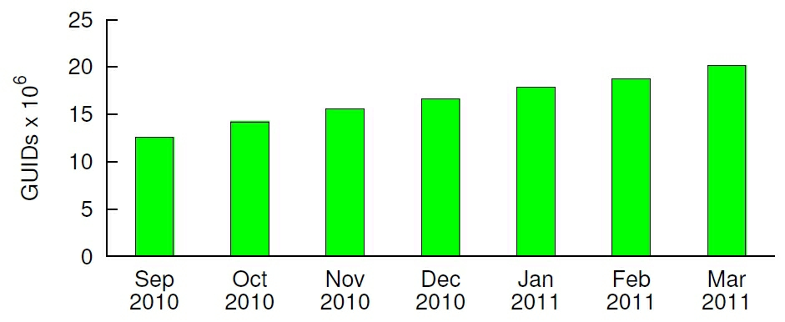
Growth in Number of Installations

Slide 21
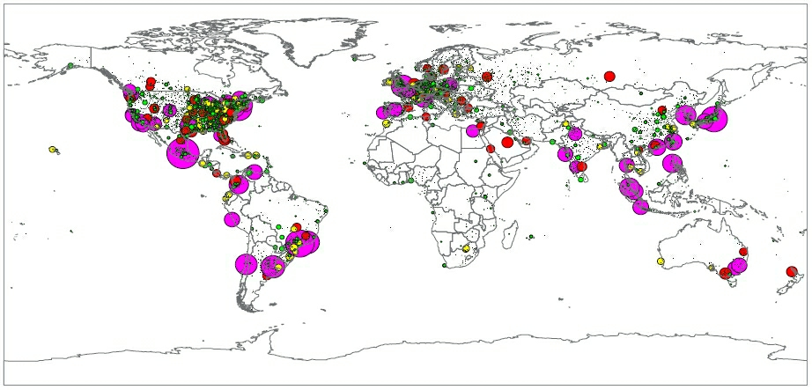
Locations of Clients per EdgeScape

Slide 22
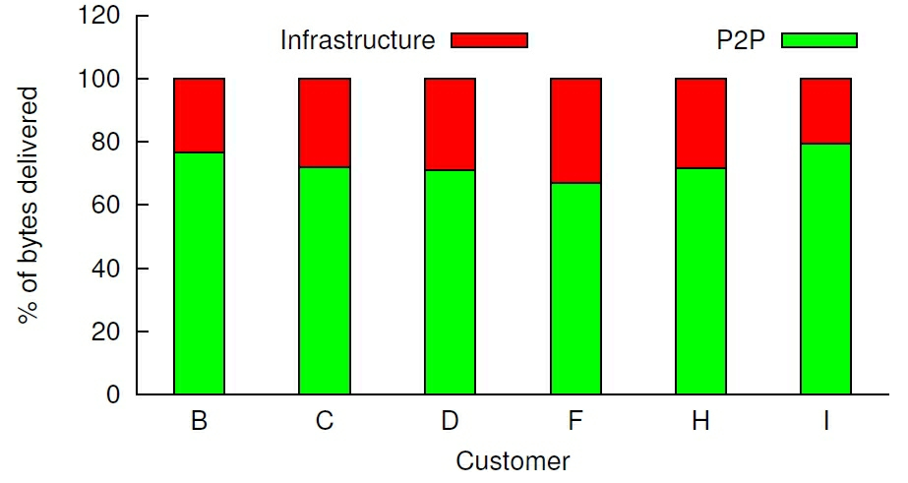
P2P Efficiency for Largest Enabled Customers

Slide 23
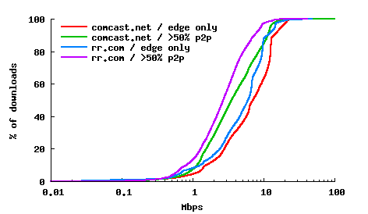
Performance
Majority P2P downloads average several Mbps.

Slide 24
Move to Full-Site Delivery
88 of Alexa top 500 home pages delivered by Akamai
Motivated in part by split-TCP/TLS optimization
Motivated in part to protect web site
Akamai has to operate DNS, hold private keys!
persistent connection
fast
establishment
alternative overlay path

Slide 25
Defending Web-Based Services from Attacks
Two Architectures:
Traditional CDN protects web sites
Packet filtering data centers provide generic protection for network-based services

Slide 26










Akamai Kona Site Defender
Origin Server
End User
Origin Traffic
Akamai Traffic
10000
10000
1000
1000
100
100
10
10
1
1

Slide 27
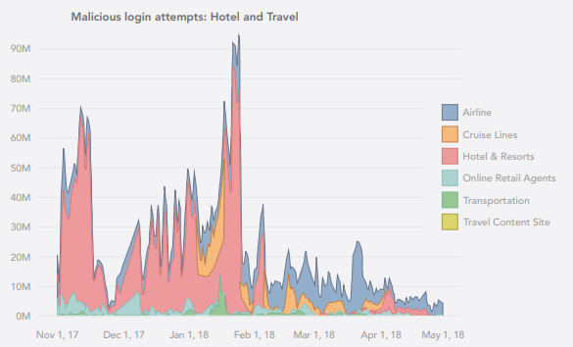
Malicious login attempts

Slide 28
Bot-Based Account Takeover: Obtain Password Dump

Slide 29
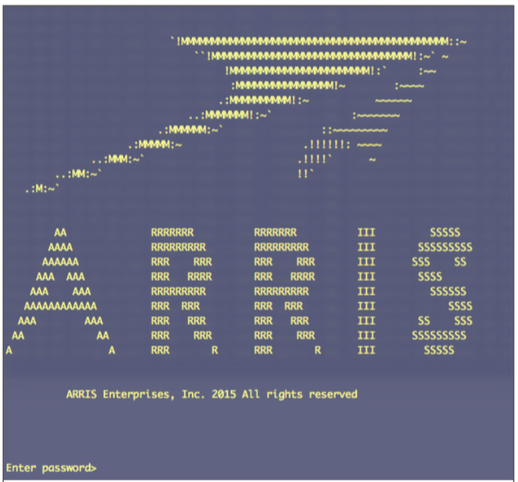
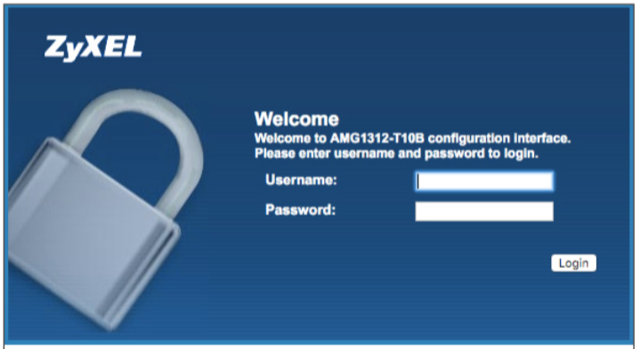
Leverage Compromised Home Cable Modems/Routers

Slide 30
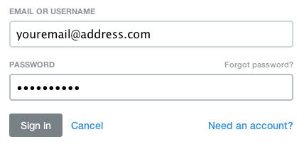
Account Takeover Campaign Attack Architecture

Slide 31
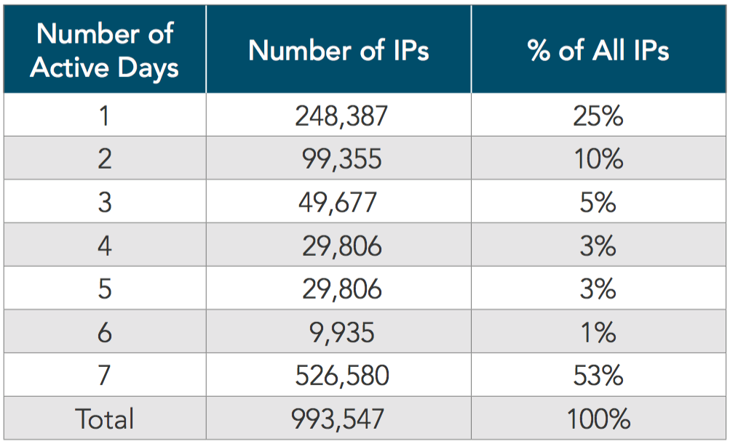
Attacking IP Persistence: Finance Customer
75% Multi-day Attackers
427,444,261 Accounts Checked

Slide 32
Distributed Denial of Service (DDOS) Attacks
The attacker hopes to overwhelm the content provider’s resources with requests for service.
Sometimes the attacker issues requests through a “bot army” of compromised or rented machines.
The attacker looks for “amplification” where an easy-to-generate request requires a large or difficult-to-generate response.

Slide 33
Prolexic IP Anycast Scrubbing Centers
128.2.205.42
Origin Server
128.2.205.42
128.2.205.42
128.2.205.42
128.2.205.42

Slide 34
Largest DDOS Attacks by Year
GitHub
Gbps
Krebs

Slide 35
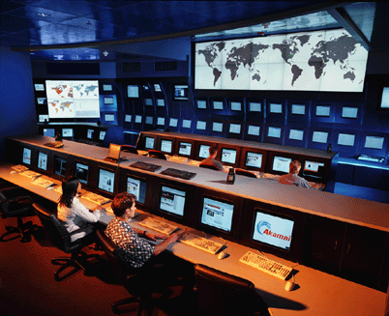

Slide 36
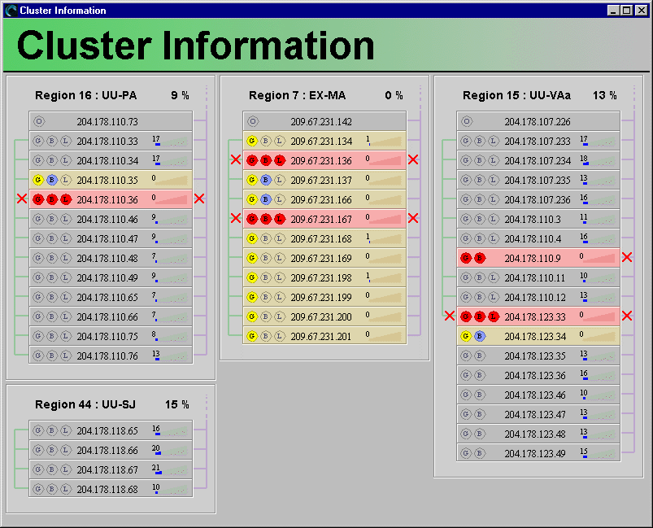
View of Clusters
buddy
suspended
hardware
failure
odd man
out
suspended
datacenter

Slide 37
Packet of Death
Akamai servers take care of each other
A router in Malaysia is taking down our whole system!
The mysterious 570-byte MTU
The “final” Linux 2.0 kernel isn’t so final
2.0.36 (Nov. 1998) ⇒ 2.0.37 (June 1999)

Slide 38
Future Directions
More centralized infrastructure? More diverse? Both?
Edge computing applications?
Enterprise security

Slide 39
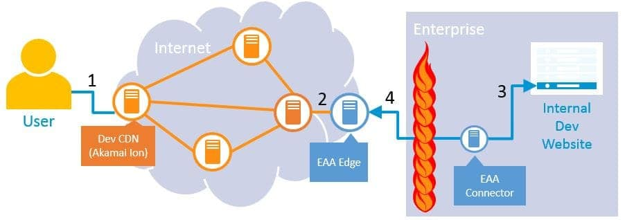
Enterprise Application Access

